Slide 1
Erik’s thesis progress report
Jan 25, 2024

Slide 2
Current Progress
Experiment almost done
Ran AIZ with 50k chemBL molecules on ALICE using slurm
Xgboost classification – OK results, more affected by data distribution, had to lower the number of classes
GNN classification/regression with chemprop – more precise and promising results
Thesis outline work in progress
TBD:
Error visualization
More models?
More data? New dataset?
Plan a meeting with Mike

Slide 3
To-do
Add saved train/test to xgboost
Calculate RMSE for the result vs. test / RMSE result per class vs test per class for regression (GNN)
Training/reading model shell script with chemprop commandline
Confusion matrix / F-1 score for classification

Slide 4
Points to address
How did you create/split data set
What was the leanring task. -regression/classification
What are the Xs and Ys (f(x) = y, x= smiles, y = route length, f ~ GNN)
Describe GNN architecture in chemprop
What are the models
How do you evaluate?
HPO (built-in in chemprop)
Generalizable?
0) remove already sampled entries
1) Sample 5k from Chembl
2) Inchi compare with CASPYRUS50k
Test size ~ 1k ~5k

Slide 5
3-15
Universal train/test set 50k for xgB and gnn
Inference on 200k using 50k GNN model for both classification and regression (exclude duplicate from 50k training sets )
Training graph with losses
How to represent results for both algs under both test sets (80-20 50k and chemBL 200k)
Classification Table – [accuracy, F1, MCC, precision, recall] in 1 table
Classification plots - adjust the font size (side improvement – split the classes: 0,1,2,3,4,5+, argue about class boundary)
Regression table – [RMSE, MAE]
Regression plot – change scatter to box plot to show the distribution
Presentation for Mike (to Alan first)
Thesis structure outline first – text later

Slide 6
Further ideas
GNN(smiles) ~ different y’s (make it plug-in and play) ()

Slide 7
Current Progress 6-11
Experiment
Universal train/test (80-20)
Model save/load for both xgB and GNN
1-click, 4 experiments with full auto graph plotting(xgB and GNN for both 1k and 50k)
200k inference running on ALICE ongoing
More meaningful graphs and metrics ongoing
Thesis outline – feedback?
Timeline discussion
1st draft
Presentation to Alan/Mike
Final Draft

Slide 8
Current Progress 6-11
Make sure 50k aligns with 200k on AIZ configs
Classification Table – [accuracy, F1, MCC, precision, recall] in 1 table
The same test set for 1k and 50k (sample 1k-train from the 50k train)
10k (in-between argument)
Look into Alan’s cites for training scores and related articles for related work
Start writing up to hypothesis (or summarize the general settings in methods) always bullet points first
More structured outline
Try finish by first week of July

Slide 9
Current Progress 8-21
200k solved from slurm
Make sure 50k aligns with 200k on AIZ configs – rerun 50k on slurm if needed
Classification Table – [accuracy, F1, MCC, precision, recall] in 1 table – can be easily made by borrowing the XGBoost result analysis calculation
Other plots:
Regression table – [RMSE, MAE]
Regression plot – change scatter to box plot to show the distribution
Loss function graph? How?
The same test set for 1k and 50k (sample 1k-train from the 50k train) – “unified inference framework”
10k (in-between argument) (must-have due to a discovery of lack of predictions of class 1-2 from the 1k model)
200k Validation experiment
Look into Alan’s cites for training scores and related articles for related work
Start writing up to hypothesis (or summarize the general settings in methods) always bullet points first
More structured outline
Try finish by first week of July

Slide 10
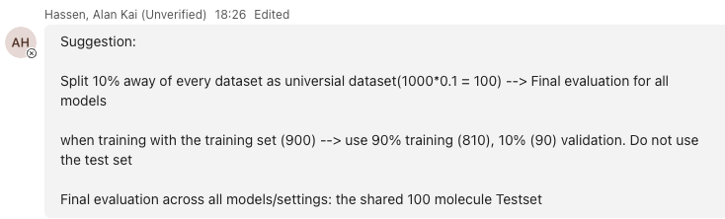
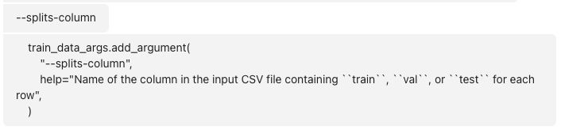
8-21 meeting notes
50k result is good, test set split is not
Redo train-test-val split, figure out a way to align xgboost with chemprop.
Chemprop does the auto-split magic that reduces number of molecules to be used for training, try to avoid that
Useful links:
https://github.com/chemprop/chemprop/blob/0c4e4f36e39c647b0edf15ce15a25a0a4f4f145a/chemprop/cli/train.py#L425
https://github.com/chemprop/chemprop/issues/639
https://machinelearningmastery.com/avoid-overfitting-by-early-stopping-with-xgboost-in-python/
https://chemprop.readthedocs.io/en/latest/tutorial/cli/train.html
https://www.tensorflow.org/tensorboard
200k ultimate validation for all models and all experiment modes
Writeup – always content first, aka graphs, cites etc, then text
data generation – Alan’s paper explains that
Argument about task formulation – classification >> regression
Methodology – why trying both?
Regression matches the chemistry intuition of how molecules grow, aka 1.7 is closer to 2 than to 1, but if using multiclass that distance can’t be told
10k extraction from 50k – just take the top
Graphs
Graph format – no title, no additional metrics on graph itself (maybe only F1 for classification?)
Loss graph – tensorboard
tensorboard --logdir ./model_0/
Go to the model folder of gnn, activate aizynth-dev, then we cans see all the loss graphs from tensorboard
Classification table and Regression table that include all experiments in one graph

Slide 11
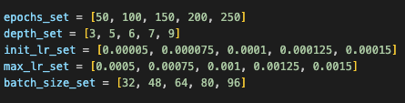
10-30 meeting notes (with Mike) - Progress
Writing
Goal from 10-09 catch up: 1st draft in 3 weeks (10-30)
Writing progress is slower than expected, but chapters such as Research Question, Methodology, and Results are finished
Experiment
Turned out to be a full GNN HPO setup (XGBoost HPO is going to be more complicated, so not considered for the time being)
50 evaluations, 5 sets of 5 parameters
The other manual tuning way is easy to implement but hard to explain/interpret+
1k optimal parameters are out
6 hours in total
10k and 50k HPO running on gpu-long in ALICE
takes very long and not sure if they will finish in 7 days
All GNN models were retrained and re-evaluated with the optimal params from 1k HPO
Significant performance increase – shown in the other slide
Params optimal – used | Epochs | Max_depth | Init_lr | Max_lr | Batch_size
1k multiclass | 50 - 150 | 5 - 6 | 5e-05 - 1e-04 | 1e-03 - 1e-03 | 96 - 64
1k regression | 150 - 150 | 7 - 6 | 7.5e-05 - 1e-04 | 1.5e-03 - 1e-03 | 48 - 64

Slide 12
10-30 meeting notes (with Mike) - Next
Writing
Feedback for 3 chapters: Research Question, Methodology, and Results (top-priority as improvements can be made before 2nd draft)
2nd (full) draft is planned to be completed by around nov 12 1pm (no Thursdays)
What/how/where should the current HPO results be interpreted/presented? (note 10k and 50k HPO results are not guaranteed)
Tables for all optimal vs chosen parameters side by side?
Plan B in case we do not have 10k and 50k HPO results – what to present?
HPO part of discussion – performance improvement on classification, to some extent makes it useful. Regression is not. Admit the limitation
Graphs – not everything has to be there, some can be moved to appendix
Experiment
Keep an eye on 10k and 50k HPO
Retrain all 10k and 50k with their optimal params? (this will take VERY long)
Graphs
text size and captions;
scaling
For the regression figures, add a line from 0,0 to 10,10
For the unsolved column, either remove or add extra caption
HPO – random search uniform sampling around the mean starting from 1k
Scale down num_evals

Slide 13
11-12 meeting notes (with Mike) - Progress
Writing
Goal from 10-30 catch up: Full draft – still work in progress
Lesson learned: never underestimate the amount of detail and research needed
Improved structure and clear outlines for all remaining chapters
Finished chapters: Backgrounds and related work, Methodology, Results (almost, waiting for HPO 50k)
Todo: Abstract, Intro, Discussion, Conclusion, and maybe reorganizing results
Q1: training loss curve?
Q2: how many articles do I need for related work? (do I have enough already?)
Q3: Argument regarding HPO
Estimated date of completion: Nov 18th (next Monday)
Experiment
Graphs scaling/tick name/font issues have been fixed with some visual improvements
New HPO framework implemented to allow grid search and random search
10k optimal parameters from grid search are out. All models retrained and re-evaluated
50k random search, num_evals = 35, 50 on the way.
The n=35 run is expected to finish in ~1 day based on a rough calculation
50k reduced grid search, n=25, 35
regression with n=25 and n=35 finished
Multiclass still running

Slide 14
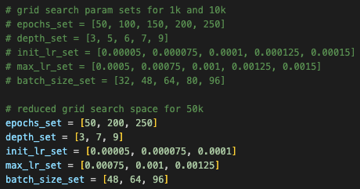
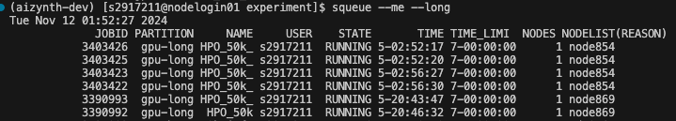
11-12 meeting notes (with Mike) - Progress
Experiment continued – HPO status
Params optimal vs. chosen | Epochs |  | Max_depth |  | Init_lr |  | Max_lr |  | Batch_size |  | Time taken
1k multiclass | 50 | 150 | 5 | 6 | 5e-05 | 1e-04 | 1e-03 | 1e-03 | 96 | 64 | 02 hours 57 mins
 |  |  |  |  |  |  |  |  |  |  | 03 hours 22 mins
1k regression | 150 | 150 | 7 | 6 | 7.5e-05 |  | 1.5e-03 |  | 48
 |  |  |  |  |  |  |  |  |  |  | 38 hours 49 mins
10k multiclass | 250 | 150 | 7 | 6 | 5e-05 |  | 7.5e-04 |  | 64
 |  |  |  |  |  |  |  |  |  |  | 37 hours 04 mins
10k regression | 200 | 150 | 3 | 6 | 1e-04 |  | 1.25e0-3 |  | 96
50k regression (reduced, n=25) | 50 |  | 3 |  | 1e-04 |  | 1.25e0-3 |  | 64 |  | 61 hours 50 mins
50k regression (reduced, n=35) | 50 |  | 3 |  | 7.5e-05 |  | 1e-03 |  | 64 |  | 74 hours 38 mins
num_evals=50

Slide 15
11-12 meeting notes (with Mike) - Next
Writing
Feedback for 3 chapters: Backgrounds and related work, Methodology, and Results
Backgrounds and related work
Explain more on algorithms used / why it makes sense to use/ properties of each method
# references are good, but read the survey paper SChwaller and look at papers that cite RAScore of Thakker for a better CASP topic coverageMethodology
HPO - Explain that we start with the biggest
Result – metrics
Regression: RMSE
Multi-class: f1 & MCC
Design a table for them (send it to Alan first for feedback)
Discussion
Experiment - What's the best model and what we found
HPO - The argument is what we have is not bad, not to find the best params
How much can we gain from adjusting them
Experiment
If random search 50k doesn’t finish, run 50k random search in embarrassingly parallel (i.e. 5*10 on slurm as random searches are independent of each other)
Start with the biggest (50k), and if necessary, continue with smaller models
Training and validation curves - investigate validation curves with unified train/val metric (train objective) on both algorithms
Training objective multiclass: Categorical Cross Entropy
Training objective regression: ?

